Slide 1
MODULE 1/1
CHAPTER -6 THE MAKING OF A SCIENTIST
SUPPLEMENTARY READER : THE FOOTPRINT WITHOUT FEET
CLASS- X
NAME OF THE TEACHER- EVA GURIA(ENG./SO.SC.)
NAME OF THE SCHOOL- A.E.C.S.NARWAPAHAR

Slide 9
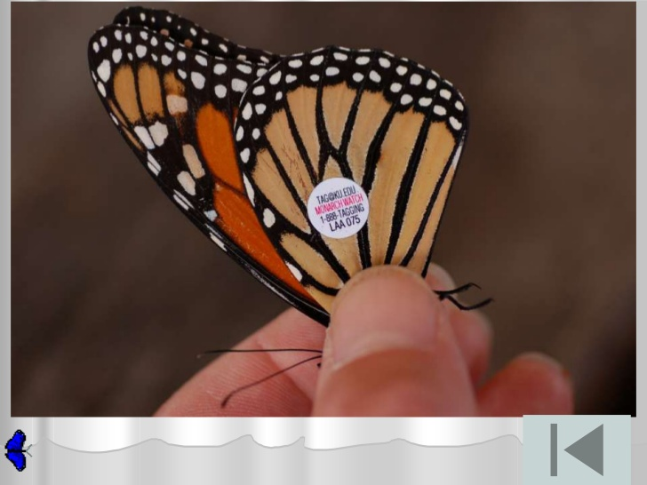
TAGGED BUTTERFLY

Slide 11
LIFE CYCLE OF A BUTTERFLY

Slide 17
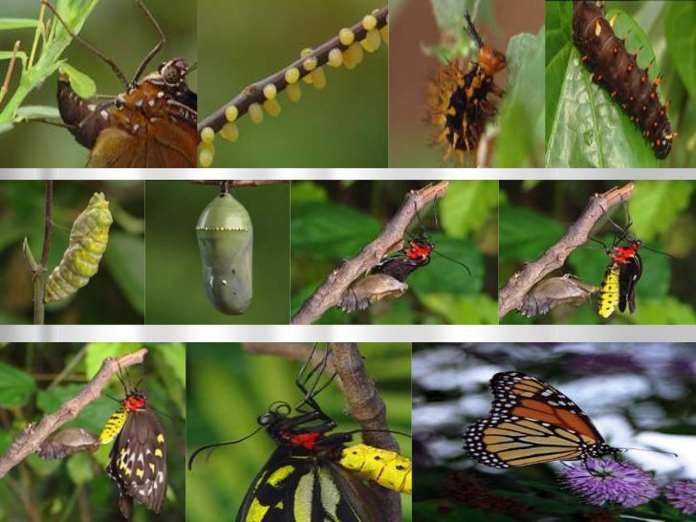
LIFE CYLE OF BUTTERFLIY

